Slide 1
Streaming SQL : Joins
Pravin Y Pawar

Slide 2
Streaming SQL :Joins
To handle data from multiple tables, we use the JOIN operator in SQL
To handle data from multiple streams, two options
First is to join the two and create one stream
Second is to write patterns across multiple streams
Reference : https://wso2.com/library/articles/2018/02/stream-processing-101-from-sql-to-streaming-sql-in-ten-minutes/

Slide 3
Streaming SQL :Joins(2)
Challenges
First challenge of joining data from multiple streams is that they need to be aligned as they come because they will have different time stamps
Second challenge is that, since streams are never-ending, the joins must be limited; otherwise the join will never end
Third challenge is that the join needs to produce results continuously as there is no end to the data

Slide 4
Streaming SQL :Joins(3)
We handle this
by keeping a window and collecting events from the one stream (which is passive in the join)
then joining new events from the other stream against the events in the window

Slide 5
Streaming SQL :Joins(4)
Example
Stream S1 has attributes “x” and “id”
Stream S2 has attributes “y” and “id”
Lets join the two streams based on ID attributes
Select x, y
From S1 as s1 join S2 as s2
on s1.id=s2.id
insert into JoinedStream

Slide 6
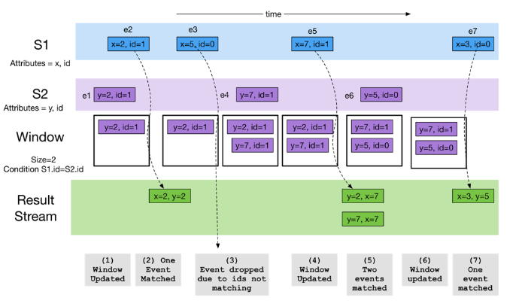
Streaming SQL :Joins(5)
Example (continued…)

Slide 7
Streaming SQL :Joins(6)
Example (continued…)
When e1 happens, it is collected in the window as it occurs in stream S2.
When e2 happens, the event is joined with e1 and produces a new event.
Event e3, which occurs in the active stream, is dropped as it does not match the ID with any events in the window.
Event e4 is retained in the window because it is in stream S2.
Event e5 matches with events in the window and generates two events as output.
Event e6 is retained in the window, and the oldest event e1 is removed as the window is of size 2.
Event e7 matches with events in the window and produces two events as output.

Slide 8
Types of Join
At least one stream has to be bounded or in other words must have a window attached
Two cases :
One window join
Two window join

Slide 9
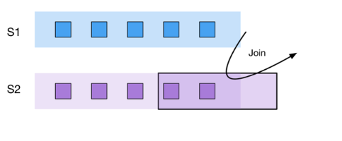
One Window Join
One stream (S2) is bounded by a window, and events retained in the window are matched against events coming in the second stream (S1)
Only events in the second stream (S1) will trigger an output

Slide 10
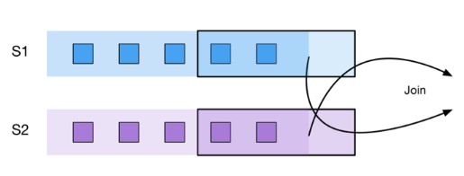
Two Window Join
A two-window query will retain events coming from both the streams in the window
A new event coming in will either trigger a match and an output

Slide 11
Thank You!
In our next session: Streaming SQL Patterns

